Slide 1
SOCKETS INTRODUCTION

Slide 2
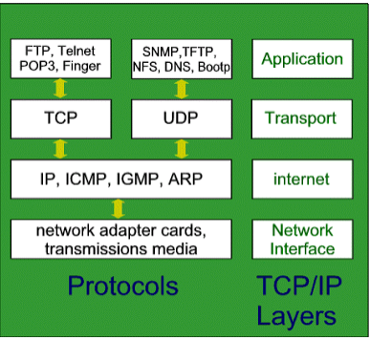
TCP/IP Layers

Slide 3
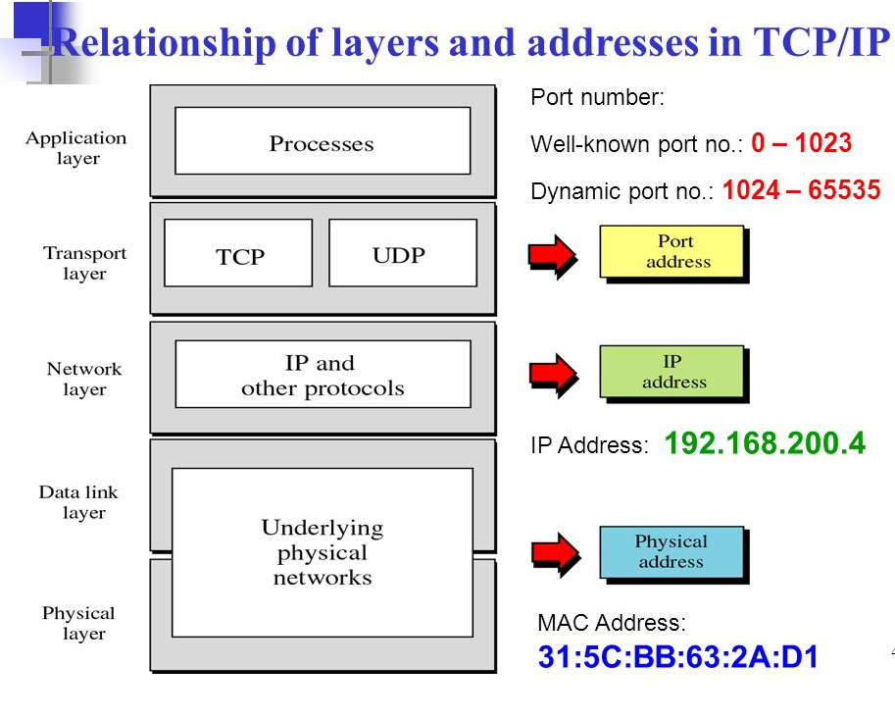


Slide 4
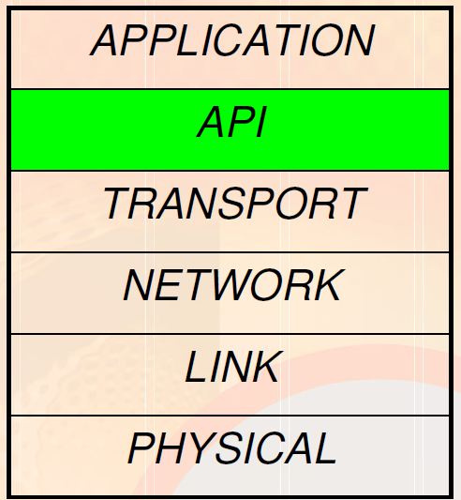
Interface to what? It is an interface to use networks
API allows application programs to access certain resources through a predefined and preferably consistent interface
A connection to the transport layer

Slide 5
Unix/windows socket
Berkeley socket interface(BSI) is the most popular among APIs that provide access to network resources(Unix)
Another popular socket interface which was derived from the BSI, is called Windows sockets or Winsock(Windows)
The socket mechanism allows programmers to write application programs without worrying about the underlying networking details.

Slide 6
SOCKET Programming in UNIX
What is “socket”?
A socket is a virtual connection between two applications
Using a socket, two processes can communicate with each other
The socket is the major communication tool for Internet applications
A socket is bi-directional (full-duplex) transmission

Slide 7
What is “socket”?
It is an abstraction that is provided to an application programmer to send or receive data to another process.
Data can be sent to or received from another process running on the same machine or a different machine.
In short , it is an end point of a data connection.

Slide 8
Sockets
It is like an end point of a connection
Exists on either side of connection
Identified by IP address and port number

Slide 9
socket interface
Application 1
Application 2
socket interface
user
user
kernel
kernel
Socket
Socket
Underlying communication Protocols
Underlying communication Protocols
Communications network
Figure 2.16

Slide 10
SOCKET Programming in UNIX
Socket as a virtual connection between two processes
Host A
Host B
Socket connection
(virtual connection)
Process 1
Process 2
Information Hiding
Network Adapter Card
Network
(physical connection)

Slide 11
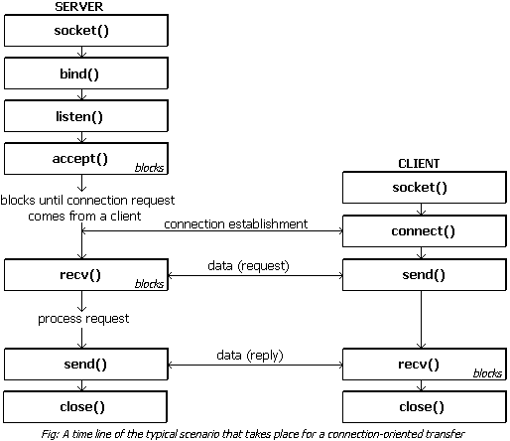
Socket System Calls for Connection-oriented Protocol

Slide 12
The server begins by carrying out a passive open as follows.
(Server when it starts, opens the door for incoming requests but never initiates a service until it is requested to do so. This is called passive open.)
The socket call creates a TCP socket.
The bind call then binds the well-known port number of the server to the socket.
The listen call turns the socket into a listening socket that can accept incoming connections from clients.
The accept call puts the server process to sleep until the arrival of a client connection.

Slide 13
The client does an active open(A client opens the communications channel using the IP address of the remote host and the well-known port address of the specific server program running on that machine).
The socket call creates a socket on the client side, and the connect call establishes the TCP connection to the server with the specified destination socket address.
When the TCP connections is completed
The accept function at the server wakes up and returns the descriptor for the given connection namely, the source IP address, source port number, destination IP address, and destination port number.
The client and server are now ready to exchange information.

Slide 14
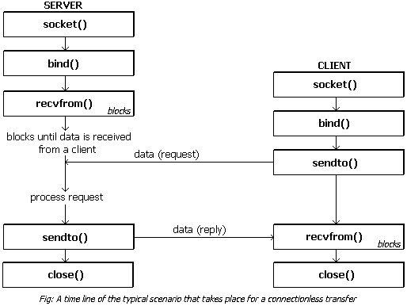
Socket System Calls for Connectionless Protocol

